Slide 1

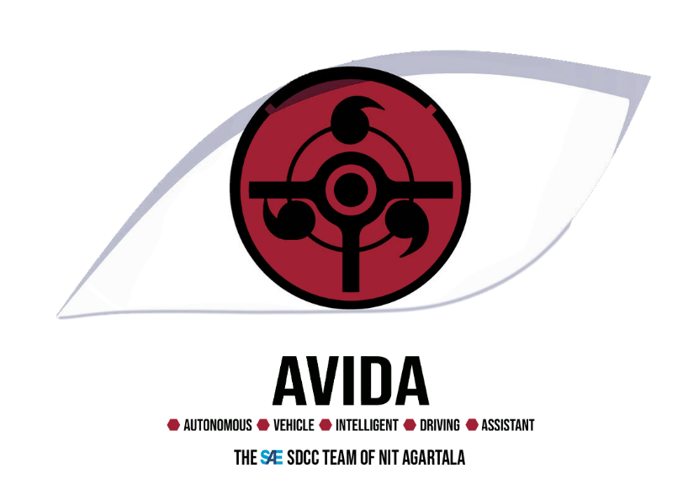
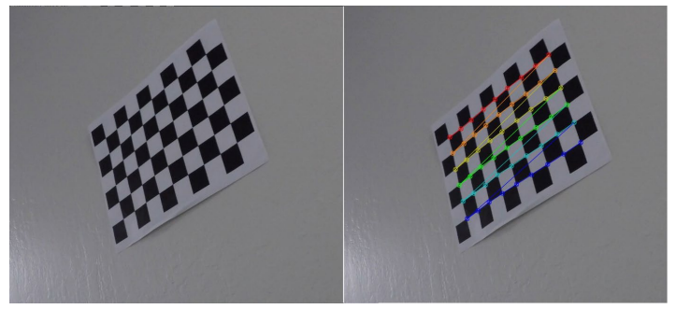
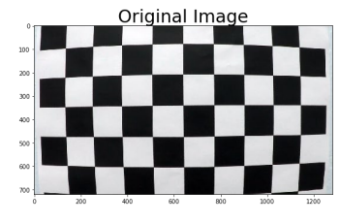
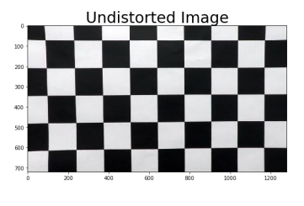
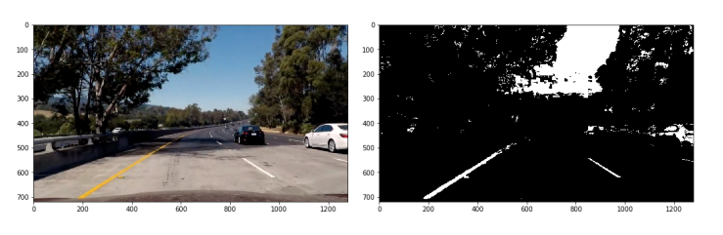
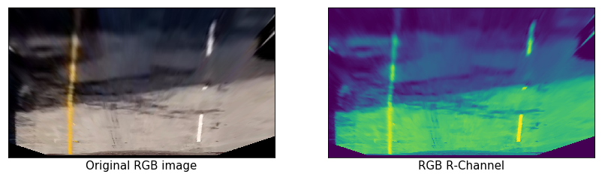
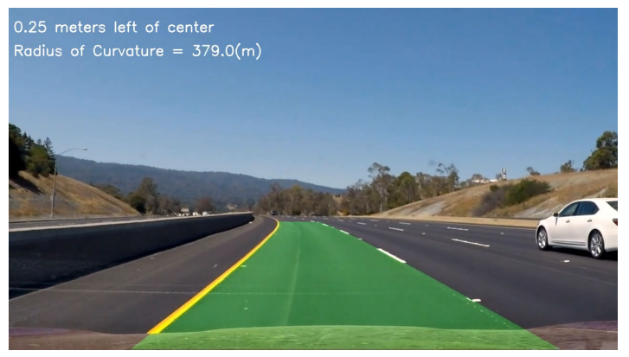
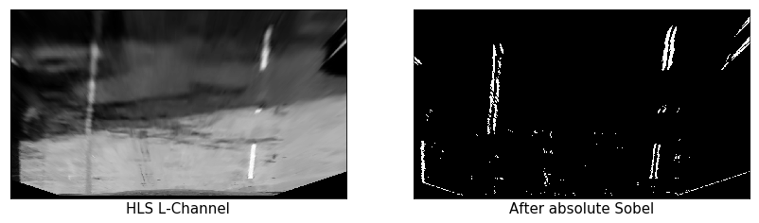
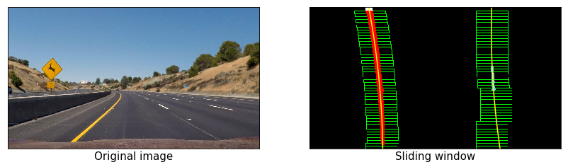
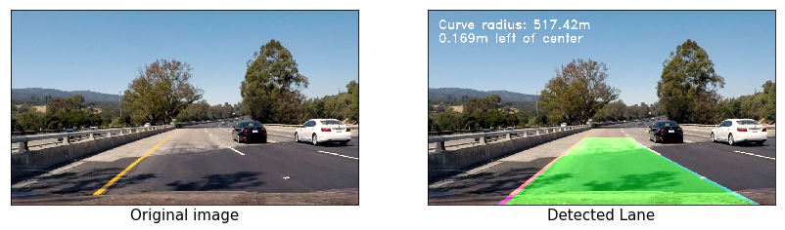
Team AVIDA
Advance Lane Detection
Sumit Anand
Abstract
Methodology
In this project, we try to detect road features like lanes, road radius curvature and road center offset.
We basically tried to enable an autonomous vehicle to visualize and its surroundings and predict regression-based values for the controller. Steps involved include camera calibration, distortion correction, thresholding, perspective transform, lane pixel detection, etc.
We were able to write a code in Python, using libraries like OpenCV and NumPy, to execute many deep learning applications.
Camera calibration
Apply a distortion correction to raw images.
Use color transforms, gradients, etc., to create a thresholded binary image.
Apply a perspective transform to generate a “bird’s-eye view” of the image.
Detect lane pixels and fit to find the lane boundary.
Determine the curvature of the lane and vehicle position with respect to the center of the car.
Warp the detected lane boundaries back onto the original image and display numerical estimation of
lane curvature and vehicle position.
Figure 1. Actual image.
Figure 2.Edge detection by OpenCV.
Introduction
Fig 3. Distortion in chess board
In this Advanced Lane Detection project, we apply computer vision techniques to augment video output with a detected road lane, road radius curvature and road center offset. The field of computer vision has a vital role in helping autonomous systems to visualize their surroundings, make inferences from pixel data and use these inferences to predict regression-based values that can be used to feed controllers that have the responsibility to guide and control the autonomous vehicle. This steps involved in this project are following:
• Compute the camera calibration matrix and distortion coefficients given a set of chessboard images.
• Apply a distortion correction to raw images.
• Use color transforms, gradients, etc., to create a thresholded binary image.
• Apply a perspective transform to rectify binary image (“birds-eye view”).
• Detect lane pixels and fit to find the lane boundary.
• Determine the curvature of the lane and vehicle position with respect to center.
• Warp the detected lane boundaries back onto the original image.
• Output visual display of the lane boundaries and numerical estimation of lane curvature and vehicle
position.
Results
Conclusions
The steps discussed in this article are great steps, to begin with, that solve the lane detection problem with absolute computer vision techniques. Several even more advanced techniques take advantage of neural networks to provide consistent, and comprehensive results even when the input data consists of varying lighting conditions and surroundings.
Camera calibration
Distortion correction and color ,Perspective transform
Determining curvature
Warping data over original image
Figure 4.Final Output.
Contact
References
Team AVIDA
Team Id- SDCC2021001
National Institute of Technology, Agartala.
LinkedIn: Team Avida/LinkedIn
Phone:7905155527
https://github.com/mohamedameen93/Advanced-Lane-Finding-Using-OpenCV
https://github.com/OanaGaskey/Advanced-Lane-Detection
https://www.linkedin.com/pulse/chapter-2-self-driving-car-advanced-lane-finding-theory-snoussi/
https://medium.com/@NickHortovanyi/advanced-lane-detection-8b98b79b9cac
https://medium.com/@NickHortovanyi/advanced-lane-detection-8b98b79b9cac
https://towardsdatascience.com/advanced-lane-detection-for-autonomous-vehicles-using-computer-vision-techniques-f229e4245e41

